Slide 1


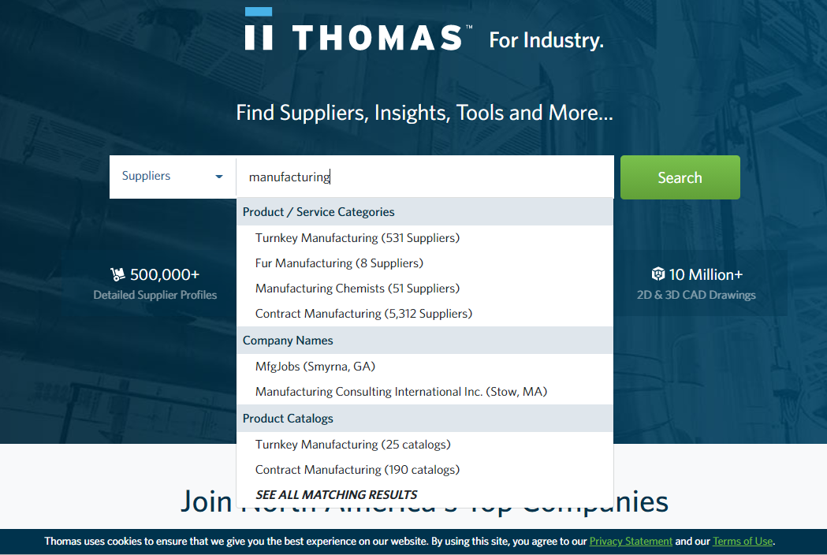
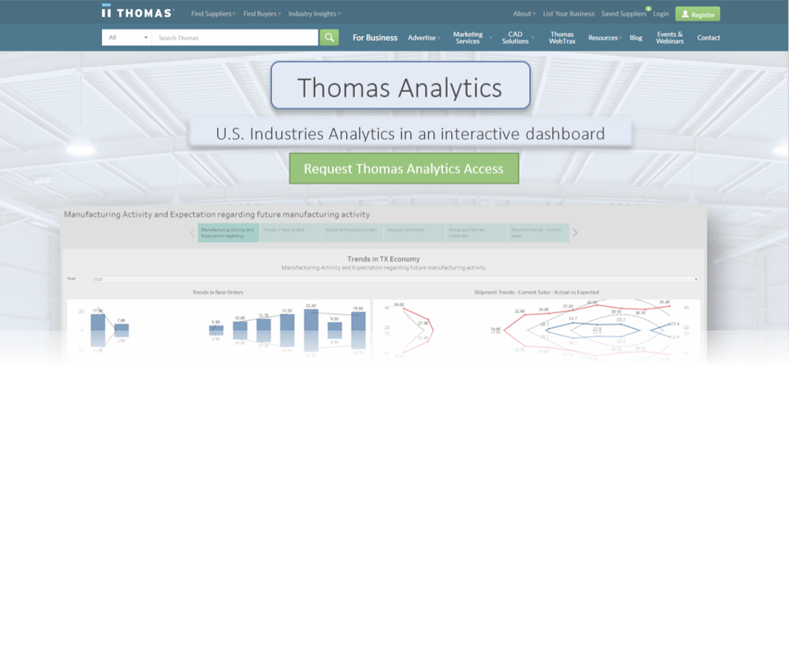
I want to set up a new business in Texas. Let’s see if it would be a good idea.
A prospective client wants to take a step in the manufacturing sector and is thinking of opening a business in Texas.
He stumbles upon the Thomas Net website. He looks for manufacturing sector and finds all these other companies
listed with Thomas Net in this sector. He knows about the
ease of using Thomas Net and is wondering if his new firm
should get enlisted with the network as well.
He then finds the Thomas Analytics Dashboards and looks through the trends in daily, monthly, yearly demands, the most popular supplier industries which would help him think about what kind of business he should set up.

Slide 2
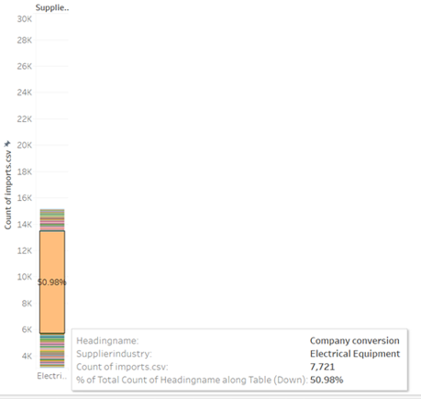
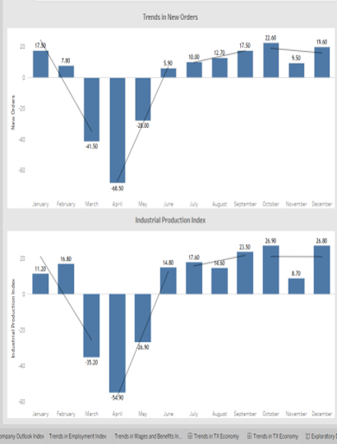
The conversion rate of these sectors which would provide foresight about the possibility of turning a profit, about getting prospective users directed to your website which would potentially generate more sales and turn a profit.
He finds another dashboard visualizing the
economic trends in the manufacturing sector
for a particular year.
He wants to know if getting into manufacturing in Texas would be a good idea, considering COVID massively affecting all the sectors. He looks at the trends for all these economic factors that drive the manufacturing sector.

Slide 3
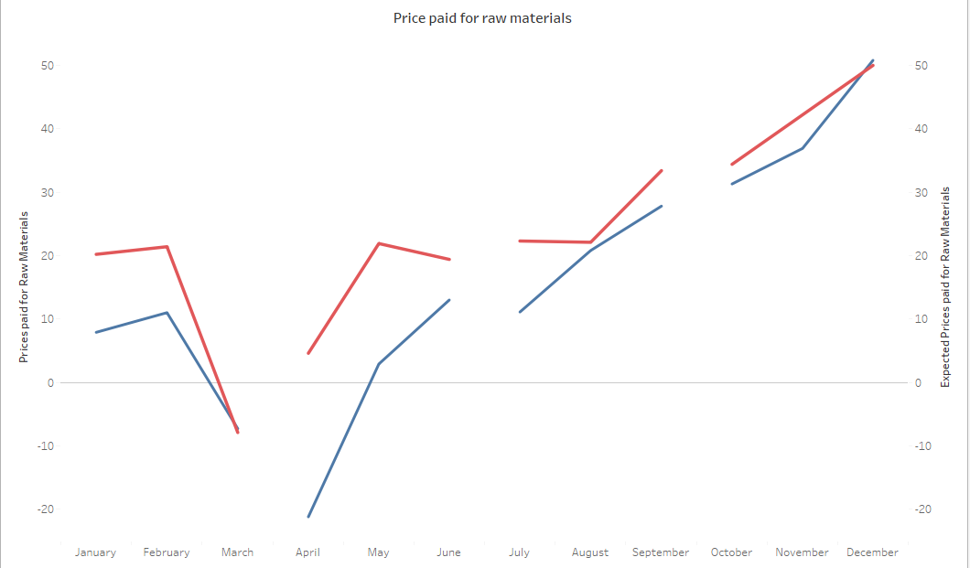

He looks at Price and Wage pressures like the prices paid for raw materials to see if Texas will be the best location to set up a business for manufacturing the products in demand.
For 2020, he sees a major difference between the expected prices and the actual prices and how the markets have stabilized after the major dip, for the experts to have realistic expectations and correctly forecast future
behavior in this sector.
He can now plan based on the economic trends and the visitor information, about the type of business he wants to set up, the location of his business and if enlisting with Thomas Net would help him increase his sales.

